Slide 1

SOC ESTIMATION OF LITHIUM ION BATTERY
In supervision of
-Dr. N. K. Swami Naidu

Slide 2

CONTETS
Lithium ion batteries
Battery management system
State of charge
Techniques of estimating
Software simulations
conclusion

Slide 3
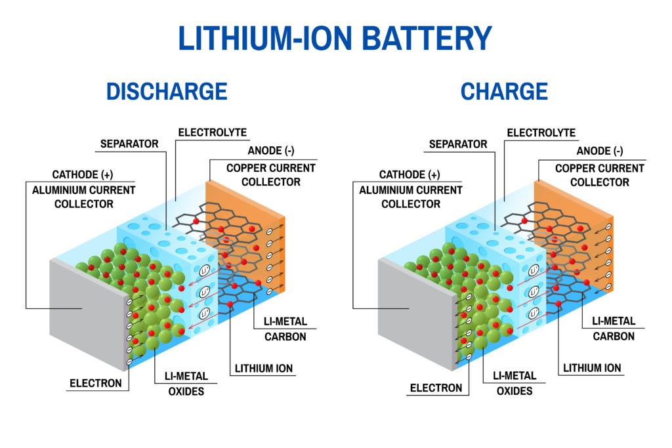
Lithium-ion battery architecture

Slide 4
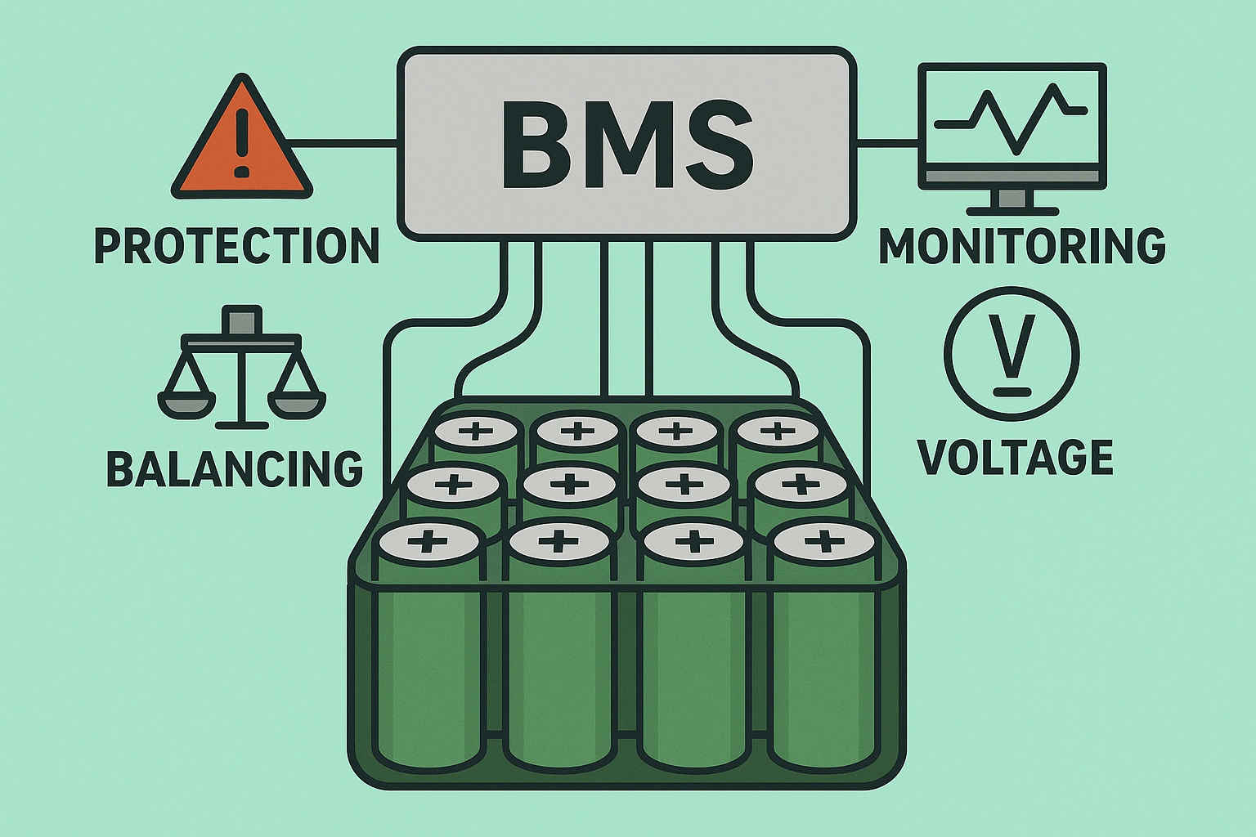
BATTERY MANAGEMENT SYSTEM
Lithium-ion batteries are now most widely used battery. Many of our daily life's things like our smartphones, laptop, EV’s all uses lithium-ion batteries for power storage.
The global battery management system (BMS) market size was estimated at around $8.6 billion in 2023 and is projected to reach $17.2 billion by 2029 according to GlobeNewswire.
Growing demand of batteries in daily life also requires more safety and that need to properly manage the battery.
A Battery Management System (BMS) is a crucial component in battery-powered systems like electric vehicles, solar energy systems, UPS, and portable electronics. It ensures safe, reliable, and efficient operation of battery packs.

Slide 5

BMS monitors the voltage current and temperature of the battery and based on these parameters it estimate State of charge (SOC) and State of health (SOH), manages heat generation and optimizes power of the battery.

Slide 6

State of charge
📌 Definition: The State of Charge (SoC) represents the percentage of available battery energy relative to its full capacity.
📌 Measurement Methods:
Voltage-Based: Uses battery voltage as an indicator of charge level.
Current Integration (Coulomb Counting): Tracks charge entering and leaving the battery.
Kalman Filtering: Advanced technique improving SoC accuracy.
📌 Importance of SoC: ✔ Optimizes battery performance. ✔ Prevents overcharging & deep discharge. ✔ Essential for Electric Vehicles (EVs) & energy storage systems.
📌 Key Influencing Factors:⚡Temperature Variations ⚡ Battery Aging ⚡ Discharge Rate Impact

Slide 7
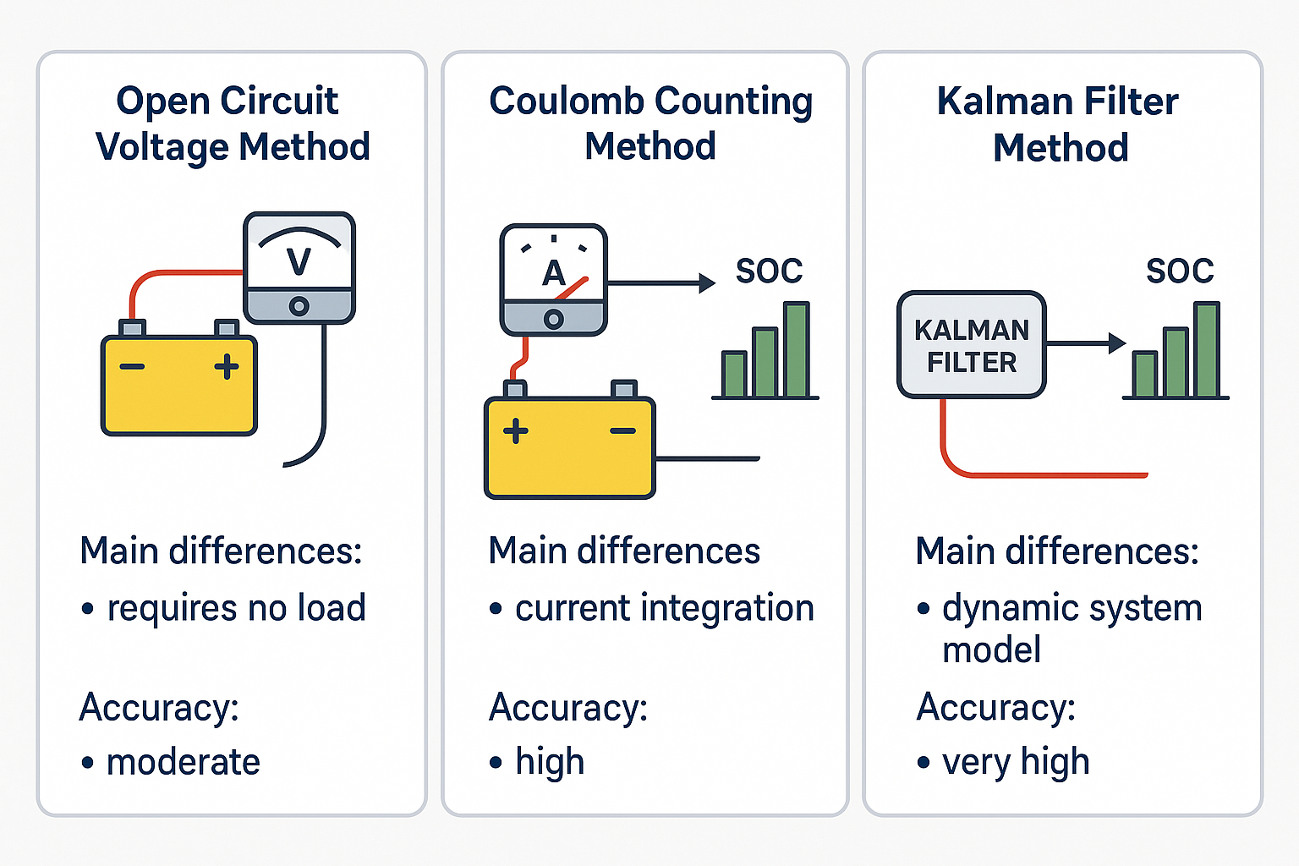
Techniques of soc estimation
Estimating the state of charge (soc) of a lithium-ion battery is crucial for battery management systems (BMS) to ensure optimal performance and longevity. Various techniques are used to determine soc accurately. We will discuss three of them

Slide 8
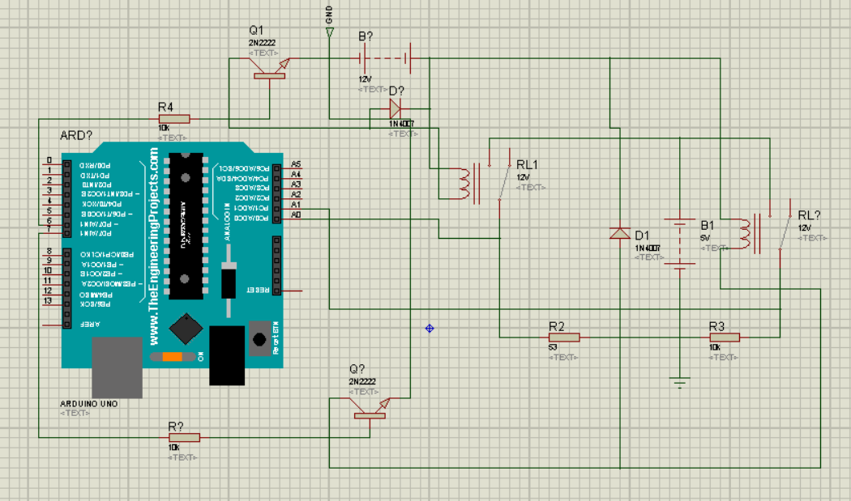
Simulation for ocv in proteus

Slide 9
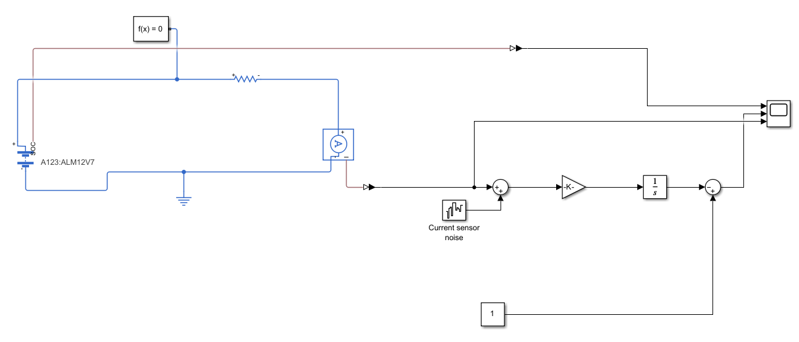
Simulation of coulomb counting

Slide 10
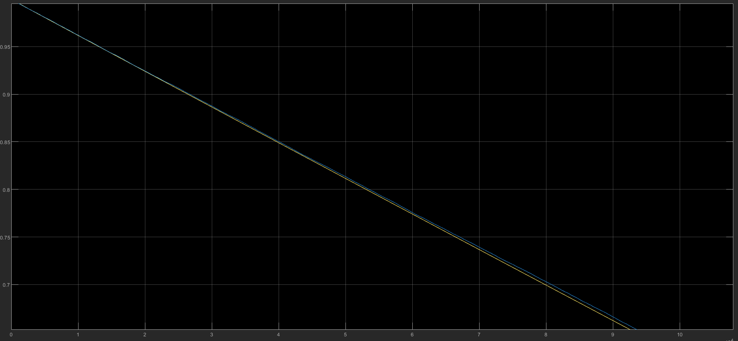
Simulation of coulomb counting

Slide 11
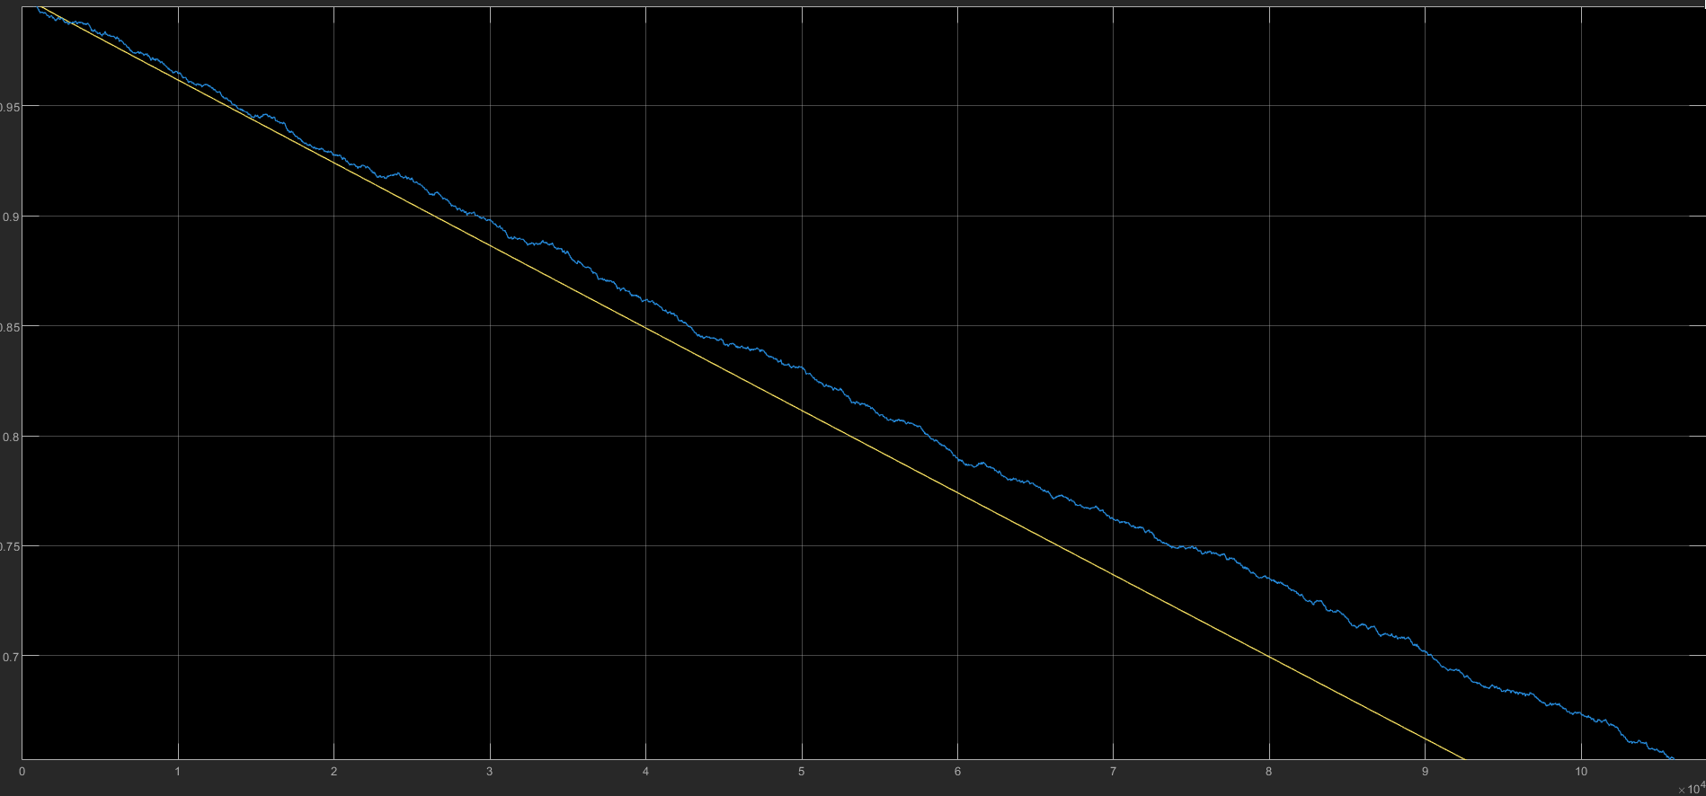
Simulation of coulomb counting

Slide 12
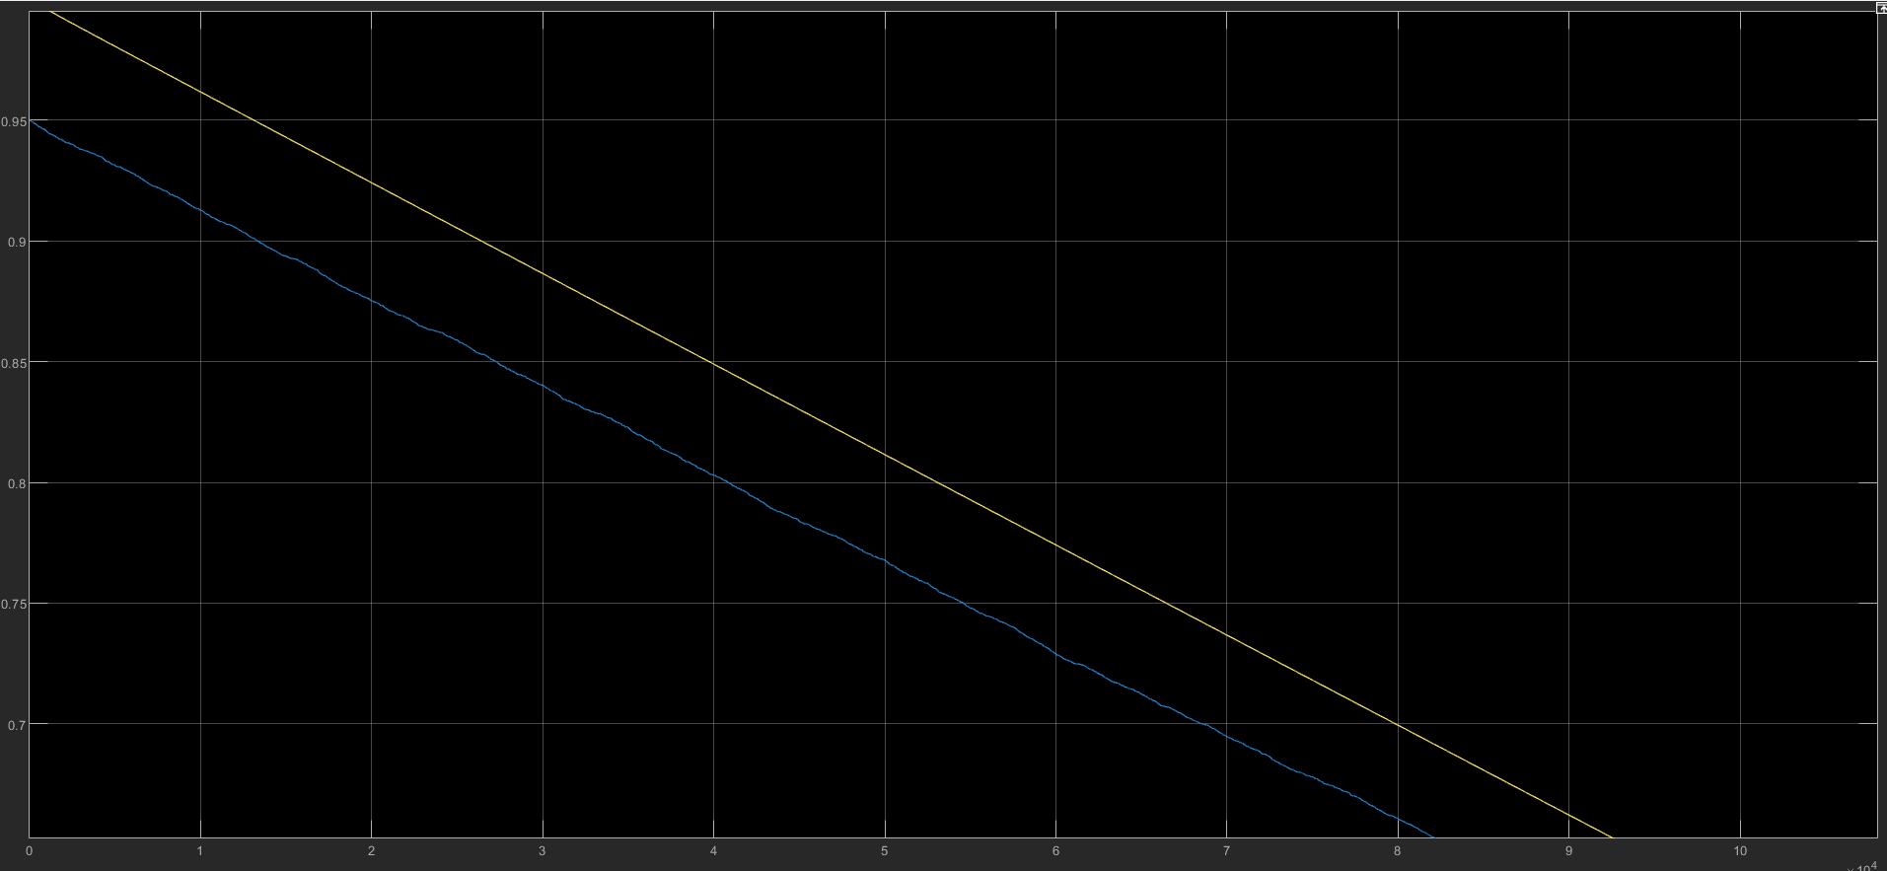
Simulation of coulomb counting

Slide 13
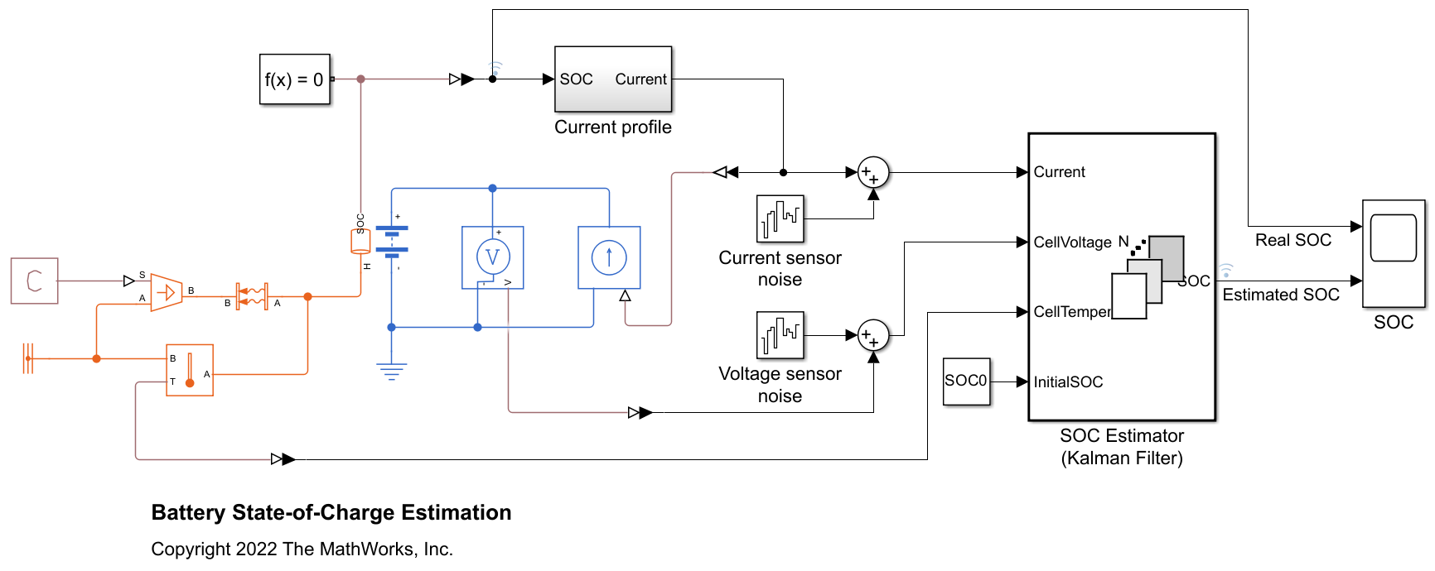
Simulation of Kalman filter

Slide 14
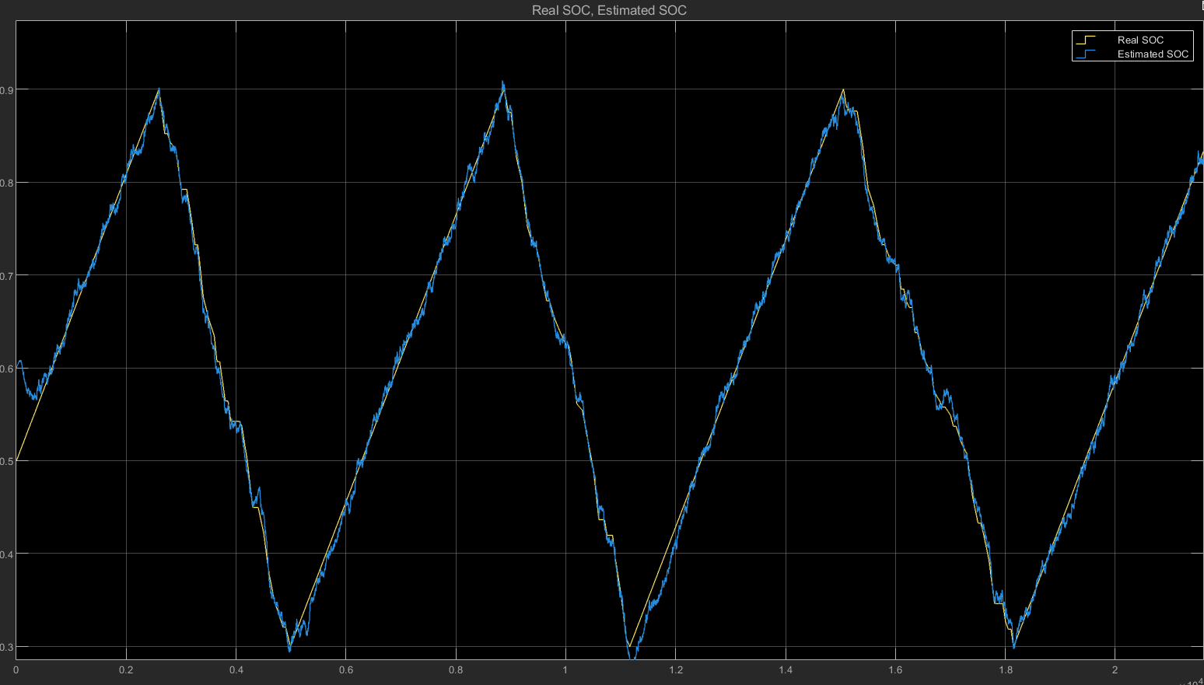
Simulation of Kalman filter

Slide 15
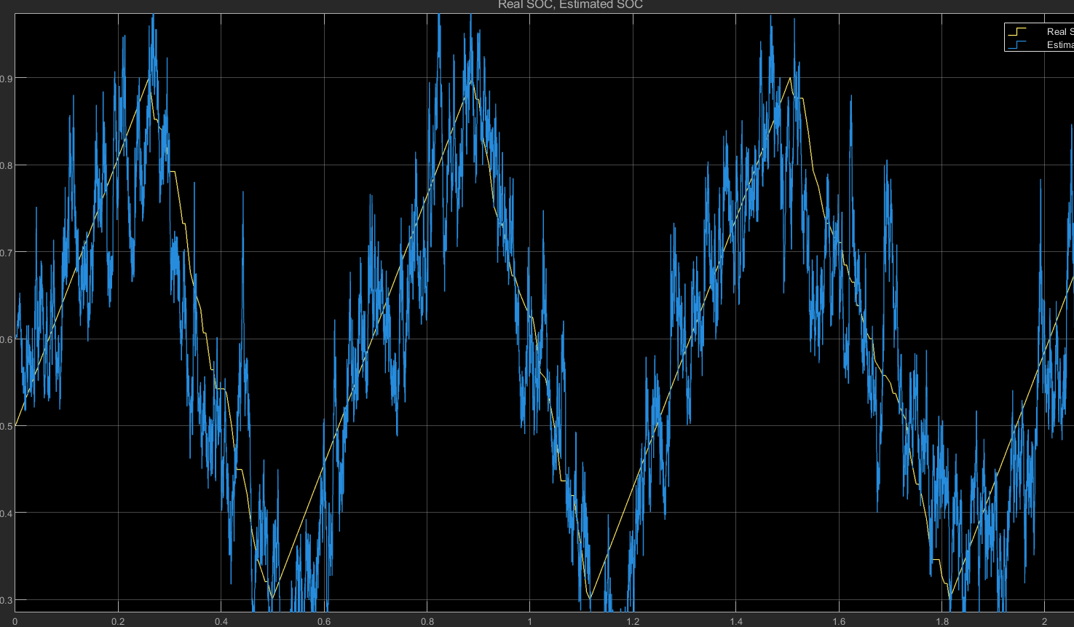
Simulation of Kalman filter WITH HIGH NOISE SENSOR

Slide 16
summary
Open circuit voltage based soc estimation of the battery is a good way of estimation of the battery but its accuracy goes down with aging of the battery.
Coulomb counting method is better than OCV method because it is not affected by the aging of the battery.
But it highly depend on initialization value for estimation and for that we again have to follow other methods.
Also, it accumulates the error of the sensor noises and hence give inaccuracy overtime.
Kalman filter method is the best method for SOC estimation of the battery. We need to also give the initial state of charge in this process but it converges on real SOC over time.
Complexity, model dependency and tuning process noises are main drawback of Kalman filter based method.

Slide 17

Thank you
Shivansh Mishra | shivansh.mishra.cd.eee23@itbhu.ac.in | +91-7703808613

